Slide 1
Conditional Probability, Bayes Theorem

Slide 2
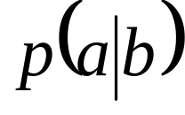
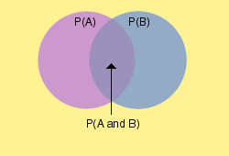
Conditional Probability
“Chance” of an event given that something is true
Notation:
  Probability of event a, given b is true
Applications:
  Diagnosis of medical conditions (Sensitivity/Specificity)
  Data Analysis and model comparison
  Markov Processes

Slide 3
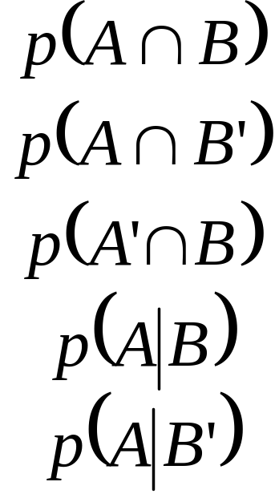
Conditional Probability Example
Diagnosis using a clinical test
Sample Space = all patients tested
  Event A: Subject has disease
  Event B: Test is positive
Interpret:
      Probability patient has disease and positive test (correct!)
      Probability patient has disease BUT negative test (false negative)
      Probability patient has no disease BUT positive test (false positive)
      Probability patient has disease given a positive test
      Probability patient has disease given a negative test

Slide 4
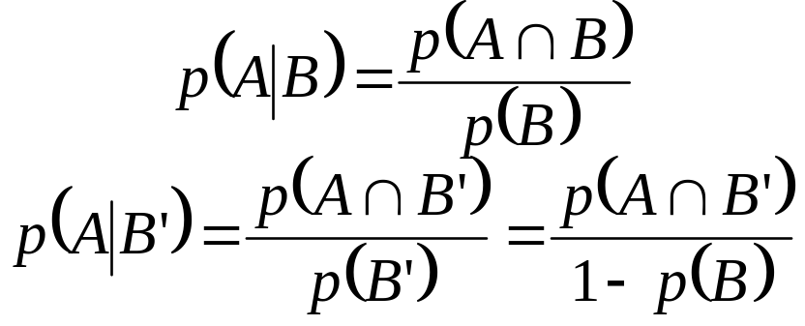
Conditional Probability Example
If only data we have is B or not B, what can we say about A being true?
  Not as simple as positive = disease, negative = healthy
  Test is not Infallible!
Probability depends on union of A and B
Must Examine independence
  Does p(A) depend on p(B)?
  Does p(B) depend on p(A)?
  Events are dependant

Slide 5
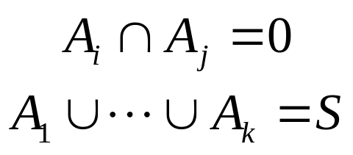
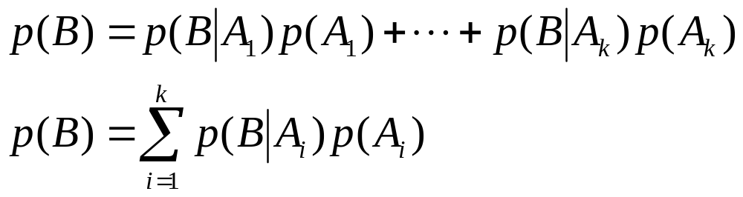
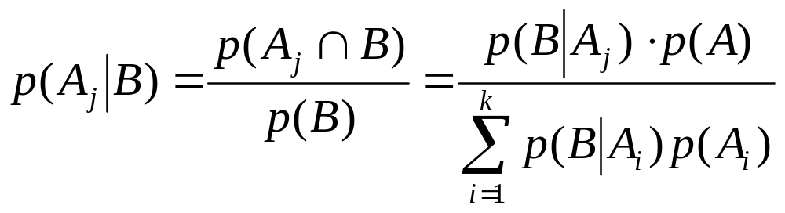
Law of Total Probability & Bayes Rule
Take events A_{i} for I = 1 to k to be:
  Mutually exclusive: for all i,j
  Exhaustive:
For any event B on S
Bayes theorem follows

Slide 6
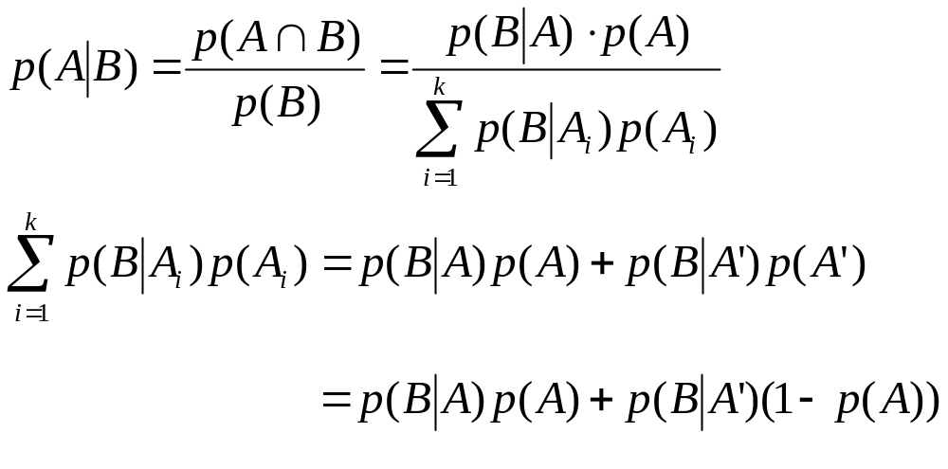
Return to Testing Example
Bayes’ theorem allows inference on A, given the test result, using knowledge of the test’s accuracy and population qualities
  p(B|A) is test’s sensitivity: TP/ (TP+FN)
  p(B|A’) is test’s false positive rate: TP/ (TP+FN)
  p(A) is occurrence of disease

Slide 7
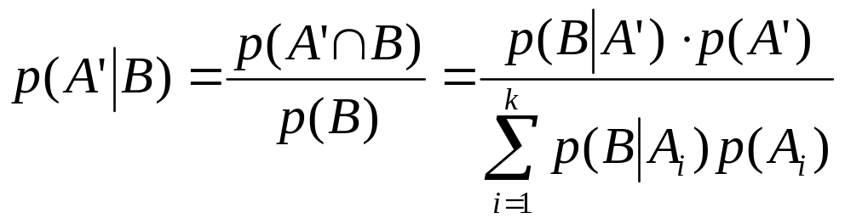
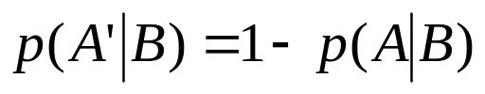
Likelihood Ratios
Similar comparison can be done to find the probability that the person does not have a disease based on the test results
Similarly, since A and A’ are independent
Here, the likelihood ratio is the ratio of the probabilities of the test being correct, to the test being wrong.

Slide 8
Numerical Example
Only 1 in 1000 people have rare disease A
  TP = .99 FP=.02
  If one randomly tested individual is positive, what is the probability they have the disease
Label events:
  A = has disease A_{o} = no disease
  B = Positive test result
Examine probabilities
  p(A) = .001
  p(A_{o})= .999
  p(B|A) = .99
  p(B|A_{o})= .02
B+
A
B-
B+
Ao
B-

Slide 9
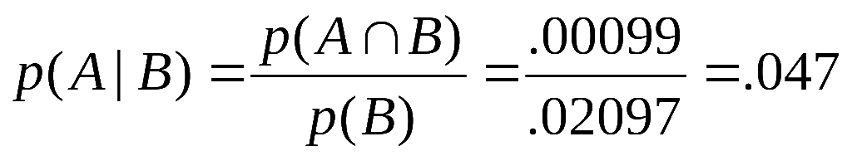
Numerical Example
Examine probabilities
  p(A) = .001
  p(A_{o})= .999
  p(B|A) = .99
  p(B|A_{o})= .02
p(A ∩ B) = .00099
B+
p(B|A) = .99
B-
A
p(A) = .001
p(B’|A)= .01
p(A_{o} ∩ B) = .01998
A_{o}
B+
p(A_{o})= .999
p(B|A_{o})= .02
B-
p(B’|A_{o})= .98

Slide 10
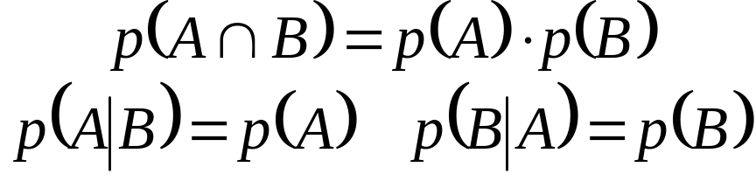
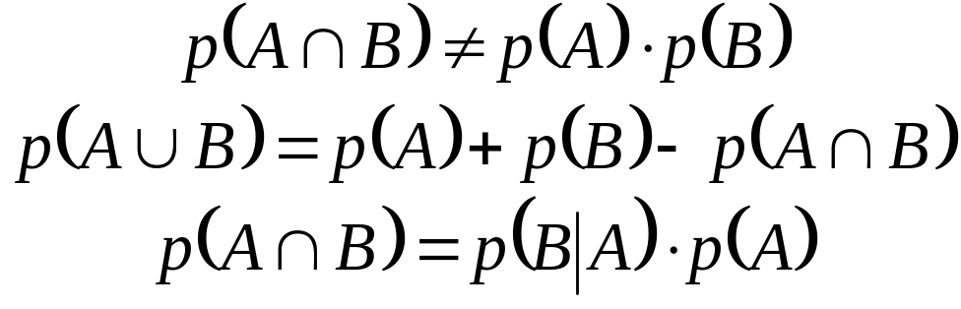
Independence
Do A and B depend on one another?
  Yes! B more likely to be true if A.
  A should be more likely if B.
If Independent
If Dependent

Slide 11
Repetition of Independent Trials
Recall
If independent trials are repeated n times, formulae may exist to simplify calculations
Examples include
  Binomial
  Multinomial
  Geometric

Slide 12
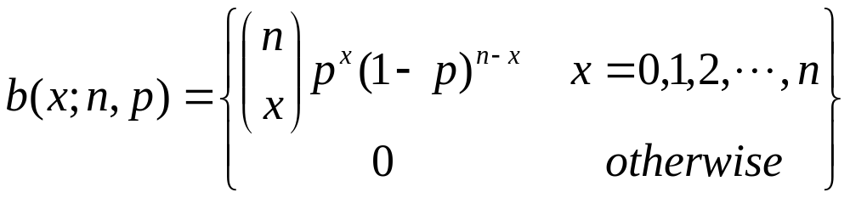
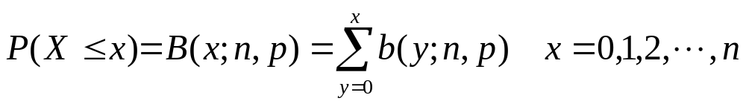
Binomial Probability Law
Requires:
  n trials each with binary outcome (0 or 1, T or F)
  Independent trials, with constant probability, p.
PDF of Binomial random variable X~ b(x;n,p)
  Where x = number of 1s (or Ts)
CDF:

Slide 13
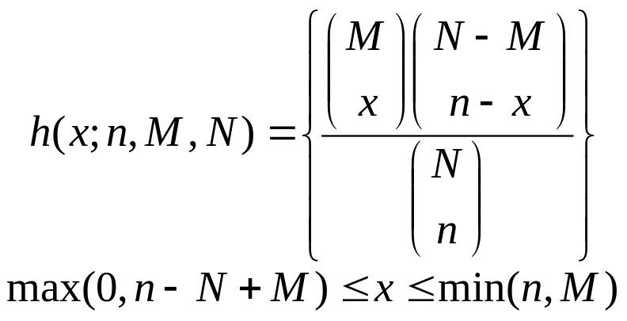
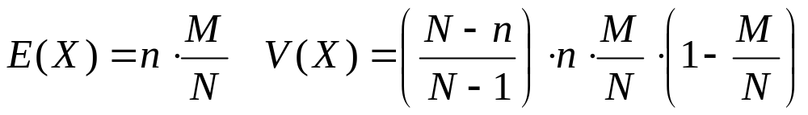
Hypergeometric Probability Law
Requires:
  Fixed, finite sample size (N)
  Each item has binary value (0 or 1, T or F), with M positive values in the population
  A sample of size n is taken without replacement
PDF of hypergeometric R.V. X~ h(x;n,M,N)

Slide 14
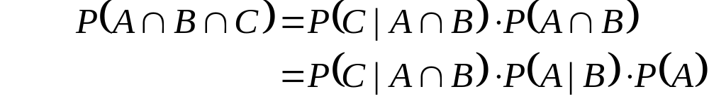
Repetition of Dependent Events
Relies on conditional probability calculations.
If a sequence of outcomes is {A,B,C}
This is the basis of Markov Chains
e.g. Two urn problem
  Two urns (0 and 1) contain balls labeled 0 or 1.
  Flip a coin to decide which jar to chose a ball from
  Pick a ball from the jar indicated by the ball chosen
  Can determine probability of the path taken using conditional probability arguments

Slide 15
Markov Chains
Given a sequence of n outcomes {a₀, a₁,..., a_{n}}
  Where P(a_{x}) depends only on a_{x-1}
Probability of the sequence is given by the product of the probability of the first event with the probabilities of all subsequent occurrences
Markov chains have been explored through simulation (Markov Chain Monte Carlo – MCMC)

